Slide 1
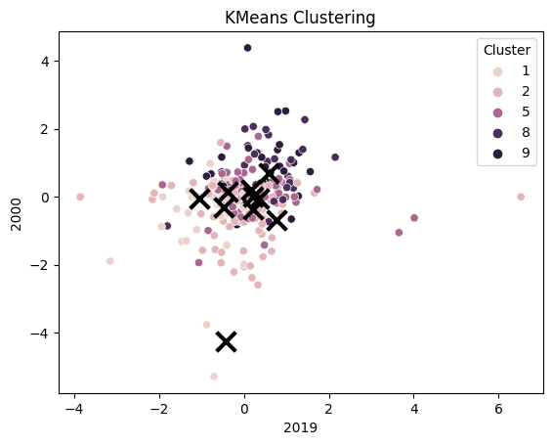
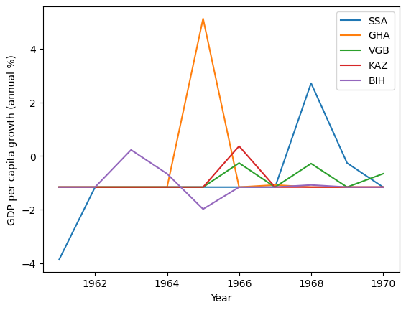
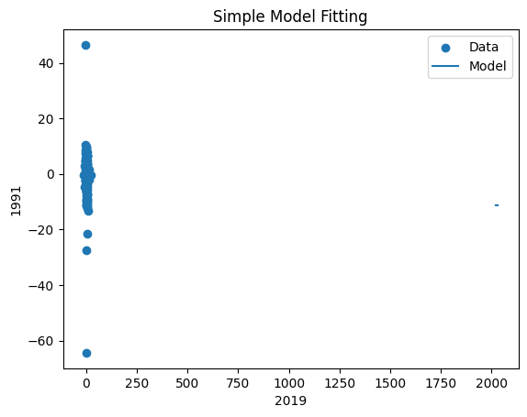
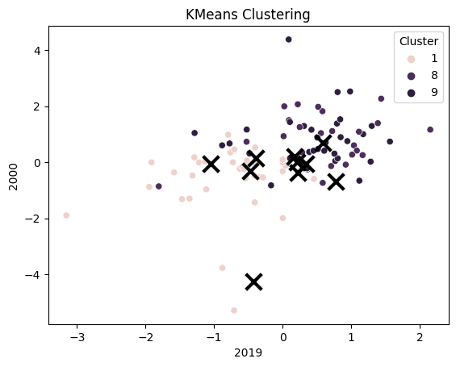
Analysis of GDP per Capita Growth (Annual %) Across Different Clusters of Countries
This poster analyzes the GDP per capita growth (annual %) of different clusters of countries from 1960 to 2021. The dataset has been clustered into five clusters, and we have analyzed the summary statistics for each cluster. The selected countries from different clusters exhibit some similarities in terms of their GDP per capita growth patterns, but also significant differences in terms of their mean, maximum, and minimum values. The clustering information provides meaningful insights into the characteristics of GDP per capita growth (annual %) across different countries and regions. The data in cluster 5 suggests that developed countries tend to have more stable and consistent GDP per capita growth (annual %) compared to developing countries. However, there are exceptions to this trend, as seen in cluster 8, which includes some developing countries with relatively stable GDP per capita growth (annual %). The data in cluster 2 and cluster 1 highlights the volatility and instability of GDP per capita growth (annual %) in low-income and middle-income countries, respectively. The data in cluster 9 suggests that even some high-income countries can experience volatile GDP per capita growth (annual %).
Strengths:
Provides a comprehensive analysis of GDP per capita growth (annual %) across different clusters of countries
Highlights the similarities and differences in GDP per capita growth patterns among selected countries from different clusters
Provides meaningful insights into the characteristics of GDP per capita growth (annual %) across different countries and regions
Weaknesses:
The dataset has some missing data, which could impact the accuracy of any conclusions drawn from the dataset
No information is provided on the source or context of the data, making it difficult to interpret the meaning of the values
The dataset has been clustered into five clusters, each with its own unique characteristics.
Cluster 5 has the most consistent and stable GDP per capita growth (annual %) compared to the other clusters.
Cluster 5 includes developed countries such as Austria, Canada, Germany, Japan, and the United States, as well as some developing countries such as Egypt and Mexico.
The data in cluster 5 is relatively tightly clustered around the mean, with a moderate amount of variability.
Cluster 2 includes mostly low-income and developing countries such as Afghanistan, Bangladesh, and Mozambique.
The data in cluster 2 is relatively widely spread around the mean, with a high amount of variability.
Cluster 1 includes mostly middle-income countries such as Argentina, Brazil, and Saudi Arabia.
The data in cluster 1 is relatively widely spread around the mean, with a high amount of variability.
Cluster 8 includes mostly Eastern European and Central Asian countries such as Armenia, Belarus, and Kazakhstan.
The data in cluster 8 is relatively tightly clustered around the mean, with a low amount of variability.
Cluster 9 includes a diverse group of countries such as China, India, Ireland, and Singapore.
The data in cluster 9 is relatively widely spread around the mean, with a high amount of variability
Simple model(s) fitting data sets with curve_fit
Conclusion: The clustering information provides meaningful insights into the characteristics of GDP per capita growth (annual %) across different countries and regions. The data in cluster 5 suggests that developed countries tend to have more stable and consistent GDP per capita growth (annual %) compared to developing countries. However, there are exceptions to this trend, as seen in cluster 8, which includes some developing countries with relatively stable GDP per capita growth (annual %). The data in cluster 2 and cluster 1 highlights the volatility and instability of GDP per capita growth (annual %) in low-income and middle-income countries, respectively. The data in cluster 9 suggests that even some high-income countries can experience volatile GDP per capita growth (annual %). However, the limitations of the dataset, such as the missing data and lack of information on the source or context of the data, should be kept in mind when interpreting the results. Overall, this analysis provides valuable insights into the characteristics of GDP per capita growth (annual %) across different clusters of countries, which could be useful for economic analysis, forecasting, and modeling.

